Slide 1
The Beginner’s Guide to ICS
HOW TO NEVER SLEEP SOUNDLY AGAIN
Dan bOUGERE

Slide 2
What We Will Cover
Intro
Overview of ICS
Contrasting ICS/OT and IT
Why This Is Scary
Call to Arms

Slide 3

whoami
Last name is pronounced BOO-zhair
15 Years in IT
Last 12 spent in various security roles
Spent time in the Intelligence Community doing “fun” things
Currently a Senior Security Consultant at Securicon, LLC
https://www.securicon.com
Notes:
Transition: So how did I end up doing SCADA work? That’s a good story….
1

Slide 4
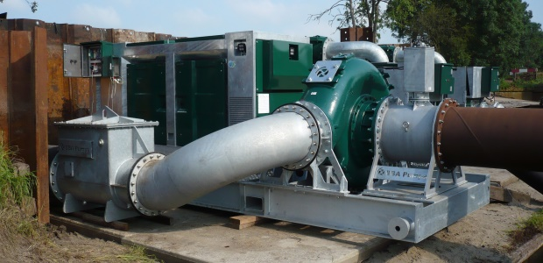
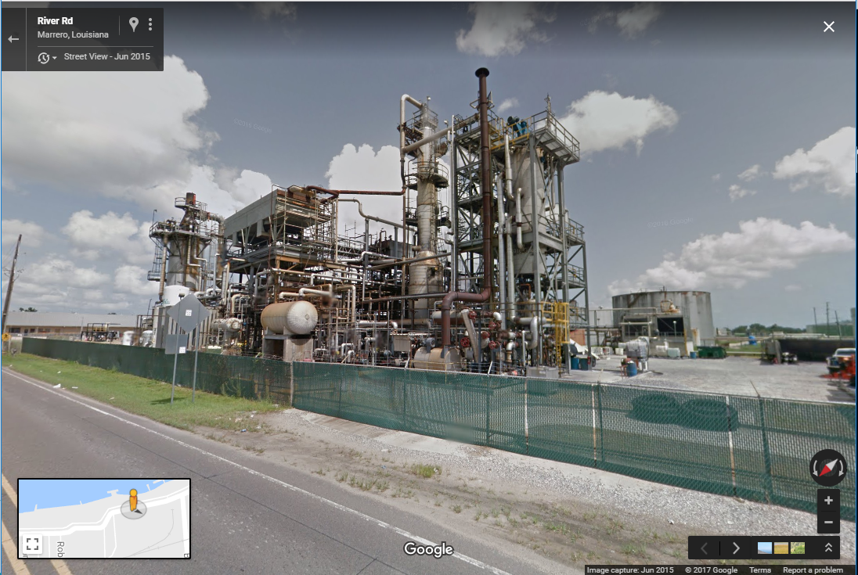
How Did I Even Start Getting Into This…
2003, pumping station
Jefferson Parish, LA
Near daily commute in Marrero, LA
Notes:
2003, pump station on West Bank. NT 3.5 in emergency center
2003, Matrix Reloaded hacking scene
2015, current job
1

Slide 5


How Did I Get Back To This…
Notes:
2003, pump station on West Bank. NT 3.5 in emergency center
2003, Matrix Reloaded hacking scene
2015, current job
1

Slide 6
Overview of ICS
Welcome to the Jungle

Slide 7
What *exactly* are we talking about?
Basically, any system that is designed to allow maximal control over a complex environment using minimal human interaction.
Repetitive yet accurate measurements
The ability to react faster than human reflexes
Precision measurements across vast geographic distances
The ability to withstand hostile or remote environments
NIST 800-82: Guide to Industrial Control Systems (ICS) Security
http://goo.gl/utQFPN
Notes:
measuring the same thing, time after time, with accuracy (pressure, voltage, volume, etc)
Cascading failure, safety interlock, circuit breaker
Pipelines, power grids, offshore drilling
Radiation, cold, heat, underwater, caustic chemicals
1

Slide 8
What *exactly* do you mean by “measurements”?
ICS systems rely on feedback loops
PID Controller Theory
Proportional – produces change proportional to error value
Integral – produces change based on duration of error value
Derivative – produces change based on the slope of change.
Fuzzy Logic
Digital: 0 (False) and 1 (True)
Uses values between these two to determine feedback
Off by a little? Slightly true (0.003)
Off by a lot? Very true (0.952)
Notes:
Proportional greatest weight in measurement
Derivative designed to reduce overshoot
Room temp measurement for example
1

Slide 9
Types of Processes
Discrete
Batch
Continuous
Hybrid

Slide 10
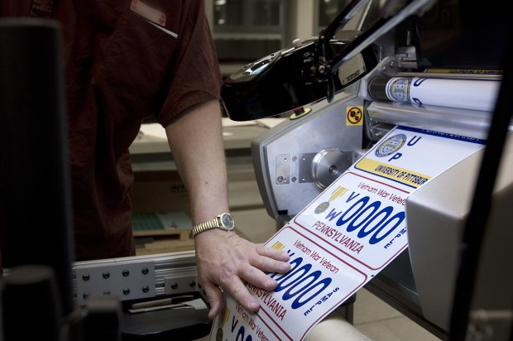
Types of Processes – Discrete
Most industrial or robotic production of individual units
Individual components responsible for one job
Think widgets
Notes:
1

Slide 11
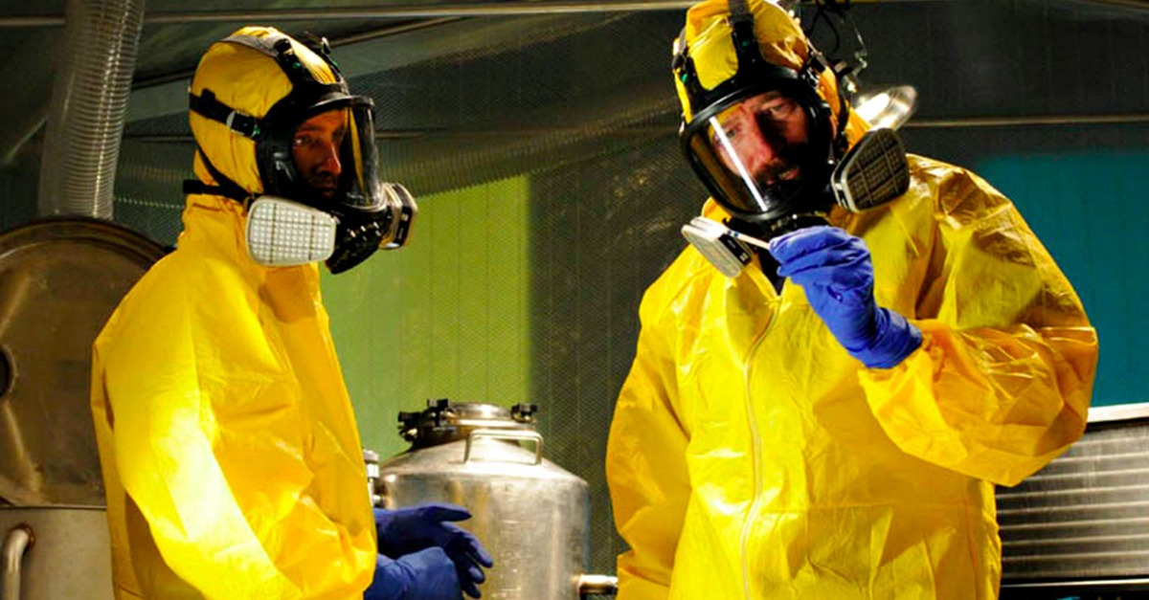
Types of Processes – Batch
Input -> Process -> Output
Mostly associated with pharmaceuticals, chemicals, food, etc.
Small to medium amounts
© AMC Networks
Notes:
1

Slide 12

Types of Processes – Continuous
Process that is generally uninterrupted over time
Constant input of materials -> constant output of product
Large quantities
© 20th Century Fox
Notes:
1

Slide 13

Types of Processes – Hybrid
Combination of any or all
An example is regional ATC
Plane takes off from continuous airport
Flight path is a discrete system of hand offs to other ATCs
Lands at destination continuous airport
Coordinated by regional ATC that monitors entire process
© 20th Century Fox
Notes:
1

Slide 14
General Categories of Systems
Distributed Control System (DCS)/Supervisory Control and Data Acquisition (SCADA)
Process Control System (PCS)
Energy Management System (EMS)
Building Management System (BMS)
Safety Instrumented System (SIS)
Notes:
DCS: First type of system. Introduced in 1975. DCS and SCADA have blurred as technology has gotten cheaper/more robust
PCS: Like it says, monitors a process or manufacturing cycle
EMS: Used to control or monitor generation or transmission systems
BMS: Used for HVAC, access, elevators, fire, water, automation, etc
SIS: Safety systems, fire, electrical, valve closure, pressure cutoff, etc
1

Slide 15
Contrasting ICS/OT and IT

Slide 16
IT Hardware
Servers
Workstations
Network Equipment
Physical Medium (Ethernet, Wireless, etc)
Routers, Switches, etc
Perimeter Defense
Notes:
Can be multiple vendor
Changed to reflect business/security trends
Generally interoperable and off-the-shelf
Typical operating environment
1

Slide 17
ICS/OT – Servers
Human Machine Interface (HMI)
Data Historian
Control Servers
Programmable Logic Controller (PLC)
Notes:
Typically one vendor
Part of an overarching plan, not easily swapped
Historically, not interoperable
1

Slide 18
ICS/OT – Workstations
Human Machine Interface (HMI)
Engineering
Programmable Logic Controller (PLC)
Older models had limited capabilities
Newer ones blur roles depending on the implementation
Notes:
Typically one vendor
Part of an overarching plan, not easily swapped
Historically, not interoperable
1

Slide 19
ICS/OT – Network Equipment
Our multi-role friend the PLC
Remote [Terminal|Telemetry] Units
Data Concentrators
Digital Protective Relay (DPR)
Intelligent End Device (IED)
Notes:
Typically one vendor
Part of an overarching plan, not easily swapped
Historically, not interoperable
DPR/IED tend to be safety equipment
1

Slide 20
IT – OS
Generic OS
Monolithic kernel for servers and workstations
Commodity microkernel for network equipment
Patched and updated (theoretically)
Commodity Software
Office Productivity Suites
AntiVirus/HIDS
Notes:
Can be multiple vendor
Changed to reflect business/security trends
Generally interoperable and off-the-shelf
Typical operating environment
1

Slide 21
ICS/OT – OS
Real Time Operating Systems (RTOS)
Different scheduling schemes that focus on eliminating locks and resource hogging (round robin, etc) along with interrupts
Bare necessities needed to function
Tend to reboot if a halt or other system delay is encountered
Typically not patched or updated proprietary code, may violate maintenance or support agreements
Popular versions
QNX
VxWorks
Windows CE

Slide 22
IT – Protocols
Overwhelmingly Ethernet, TCP/IP, Wifi, etc
Well documented and evolved
Many now have security built directly in
Designed to be interoperable between a multitude of vendors
Not overly concerned with packet or data loss, overhead, or size
Notes:
Can be multiple vendor
Changed to reflect business/security trends
Generally interoperable and off-the-shelf
Typical operating environment
1

Slide 23
ICS/OT – Protocols
Ancient design (some from late 70s)
For some, simple design is best (ModBUS)
Coil – 1 bit Boolean, read-write
Discrete Input – 1 bit Boolean, read only
Input Register – 16 bit read only, typically measurements and statuses
Holding Register – 16 bit read-write, typically configuration information
Master constructs request to read a certain value from slave, sends appropriate values in the above, slave responds accordingly and only when polled
http://goo.gl/VDRcA5 - Simply Modbus: How Does It Work?
Notes:
“Back when no one would ever do anything bad to anyone on a network….”
1

Slide 24
ICS/OT – Protocols DNP3
For others, more complexity is better (DNP3)
Binary Input/Output – measures on/off state
Analog Input/Output – voltage, current, temperature, water levels
Count – self-evident
Files – transmit to Master or Slave
Flag – single octet with fields indicating on line, restart, comm loss downstream, data is forced, over range value
http://goo.gl/0auAsW - DNP3 Primer
Notes:
“Back when no one would ever do anything bad to anyone on a network….”
1

Slide 25
ICS/OT – Protocols – DNP3 Continued
Values
16/32 bit integer
16/32 bit integer with flag
16/32 bit integer with flag and event time
16/32 bit float
16/32 bit float with flag
16/32 bit float with flag and event time
Master can poll, but slave can also report without request
http://goo.gl/0auAsW - DNP3 Primer
Notes:
“Back when no one would ever do anything bad to anyone on a network….”
1

Slide 26
ICS/OT – Protocols Cont
Many can be encapsulated
Ethernet
TCP/IP
Wifi/GPRS
But suffer drawbacks
Old equipment may not work and need media converters, bumps-in-the-wire, etc
Bad people understand these protocols very well, and the underlying protocol is a kitten in a shark tank
Notes:
“Back when no one would ever do anything bad to anyone on a network….”
1

Slide 27
IT – Focus
Business
Making money
Helping to make money
Non-Profit
Can still be about making money
Getting the message out
Confidentiality stressed over Integrity or Availability

Slide 28
ICS/OT – Focus
Basically, making sure things run as smoothly as possible with as few “human resources” as possible.
Making sure that any dangerous processes are conducted as safely as possible
Finally, making sure that the process itself is done as efficiently as possible.
Availability stressed over Integrity or Confidentiality
Notes:
1

Slide 29
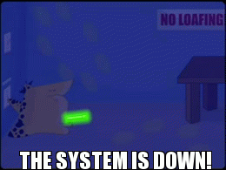
IT – Downtime
SLAs for critical systems/processes
Regular/frequent windows
Unplanned outages can be bad, but not life threatening
No matter what sales says, it isn’t actually “life threatening”
© Homestarrunner.com

Slide 30

ICS/OT – Downtime
Very expensive, even if planned
Tend to be scheduled months or years in advance
Often delayed due to various factors (expense, weather, mergers, etc)
(Very expensive)^{n} when unplanned
Can actually *BE* life threatening
Big ones usually make the news
Result in Congressional hearings
Generate whitepapers
Dogs and cats living together, Gozer, etc
© Marvel Studios

Slide 31
IT – Procurement
An unending array of commodity hardware and software
Well established interoperability
Variable regulation, depending on industry.
Mostly minor
HIPPA, PCI, etc
Some ability to tweak and fine tune setup once purchased
May be patched, upgraded, or secured with few issues

Slide 32
ICS/OT – Procurement
A restricted amount of generally proprietary hardware and software
Newly established interoperability with modern equipment
Older equipment may have to be kludged
Encapsulation helps
Moderate to substantial regulation, depending on industry.
USDA, FDA, NERC, State, etc
Slight ability to modify setup depending on service agreements
Patches? Upgrades?
Usually depends on the vendor
“Bigger fish to fry” during downtime windows

Slide 33
IT – Security
Robust solutions
Commodity scanners
Commodity drop-in boxes
Established methodologies
Many security professionals familiar with the body of knowledge

Slide 34
ICS/OT – Security
Solutions range from non-existent, to kludgy, to approaching IT levels.
Many networks have no security
Bump-in-the-wire
Encapsulation
Security methodologies are still being developed
Many security professionals UNfamiliar with the body of knowledge

Slide 35

Scanning ICS Networks Be Like….

Slide 36
Why This Is Scary
Here’s that no sleeping part…
Notes:
Transition: Stux, Duqu, Flame….old news right? Ask about Ukraine cyber attack
1

Slide 37
Ukraine Power Grid Attack
December 23, 2015 various oblenergos suffered a coordinated cyberattack that led to ~225,000 customers without power
Seven (7) 110kV and twenty-three (23) 35kV substations were disconnected from the distribution network
Forced to go to manual mode for several hours
Russia is blamed, but attribution is always the bugaboo…since Russia categorically denies any involvement
Notes:
Coordinated: around 30 minutes all were attacked
<number>

Slide 38
Ukraine Power Grid Attack – Continued
Started with spearphishing macro-enabled Word documents that installed Black Energy 3
Required users to enable macros on popup
Yes, they clicked them.
Once C&C established, cred harvesting and lateral movement began
Found VPNs into the network
Found engineering and process servers on SCADA network
Laid low and observed
Notes:
<number>

Slide 39
Ukraine Power Grid Attack – Continued 2
December, in Ukraine. Pretty toasty time of year…
Time to cry havoc and let slip the dogs of war!
Not only were substations disconnected, but the attackers configured one oblenergo’s UPS to fail at the central office once the attacks began.
Also installed malware into media converters that bricked the devices.
And for good measure, DOS’d the call center too.
SANS Blog Post - https://goo.gl/EHTH6e
Notes:
Transition: But Dan, you say…that’s Ukraine and an alleged state actor….
<number>

Slide 40


Slide 41
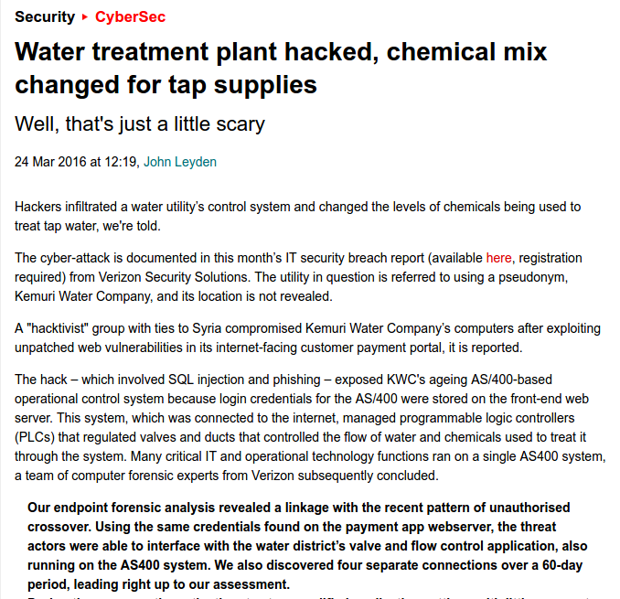
About That…
http://goo.gl/RwDGzL

Slide 42
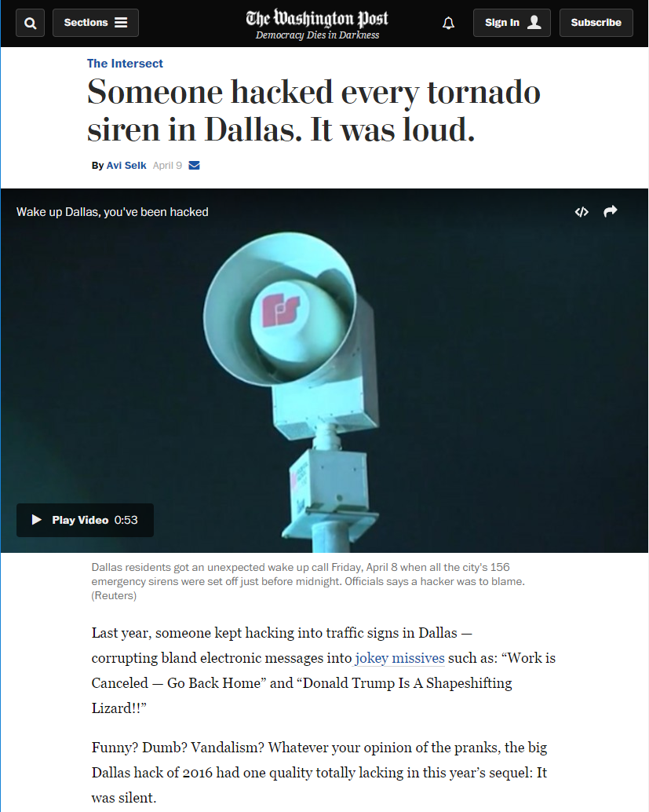
And This…
https://goo.gl/o3Jsa7

Slide 43


Slide 44
Help Us….Help You
If you work in environments like this, or you know people who do:
Please, tell them (or better show them) this is important.
Report anything you run across (nicely!)
Contribute to projects that try to secure this environment
Samurai
Various scanners (nmap, Metasploit aux, etc)
Call Securicon. We’d be GLAD to help!

Slide 45




Dan.Bougere@Securicon.com
dbougere@gmail.com
@Rouxgaru
https://www.linkedin.com/in/danbougere
Slides: https://github.com/Rouxgaru/slides

